Slide 1
Computer Operating System Experiment

Slide 2
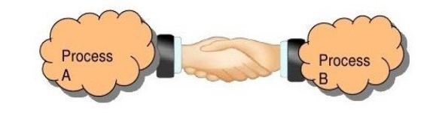
Inter-Process Communication
Lab 3

Slide 3
Roadmap
What is Inter-Process Communication?
How to use IPC in Linux?
Q&A

Slide 4
Objective:
The objective of this lab is to help you internalize a couple of important facts about IPC in Linux. Including:
  Shared memory
  Ordinary Pipes
  Name Pipes

Slide 5

What is Inter process communication
Inter process communication (IPC) is a mechanism which allows processes to communicate with each other and synchronize their actions.
  Shared memory
  Message passing
    Pipes
    Message queue
    Sockets
(a) Message passing
(b) Shared memory.

Slide 6
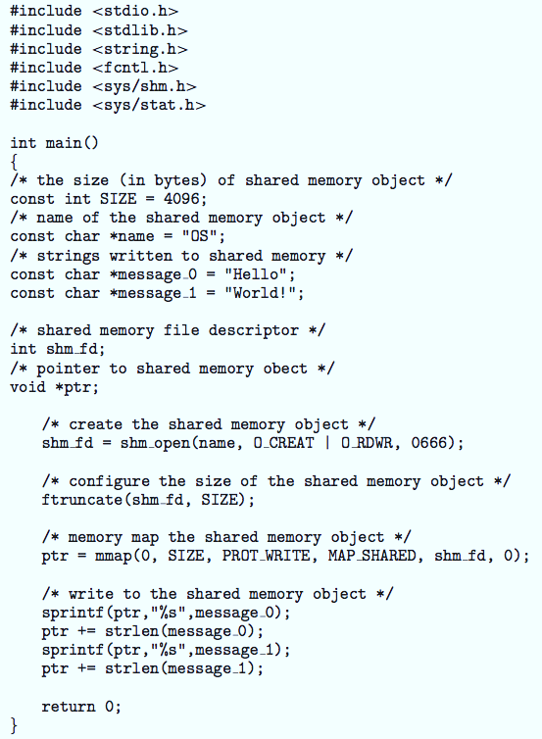
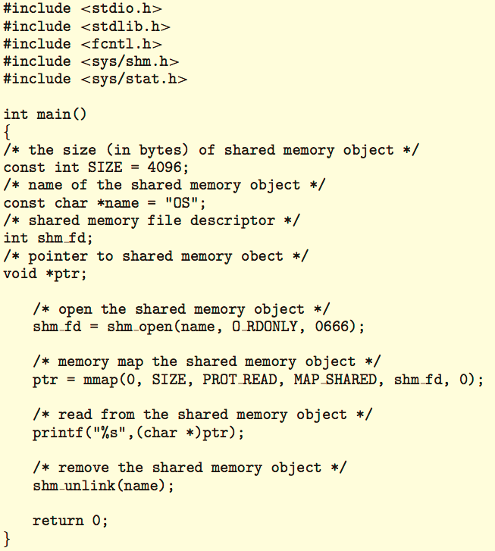
POSIX examples of shared memory: (sender->receiver)
Producer
Consumer
Notes:
An area of memory shared among the processes that wish to communicate
The communication is under the control of the users processes not the operating system.
Major issues is to provide mechanism that will allow the user processes to synchronize their actions when they access shared memory.
Synchronization is discussed in great details in Chapter 5.

Slide 7
Pipes
Acts as a conduit allowing two processes to communicate
Ordinary pipes
  cannot be accessed from outside the process that created it. Typically, a parent process creates a pipe and uses it to communicate with a child process that it created.
Named pipes
  can be accessed without a parent-child relationship.
Notes:
Acts as a conduit allowing two processes to communicate
Issues:
Is communication unidirectional or bidirectional?
In the case of two-way communication, is it half or full-duplex?
Must there exist a relationship (i.e., parent-child) between the communicating processes?
Can the pipes be used over a network?
Ordinary pipes – cannot be accessed from outside the process that created it. Typically, a parent process creates a pipe and uses it to communicate with a child process that it created.
Named pipes – can be accessed without a parent-child relationship.

Slide 8

Ordinary Pipes
Ordinary Pipes allow communication in standard producer-consumer style
Producer writes to one end (the write-end of the pipe)
Consumer reads from the other end (the read-end of the pipe)
Ordinary pipes are therefore unidirectional
Require parent-child relationship between communicating processes
Windows calls these anonymous pipes

Slide 9
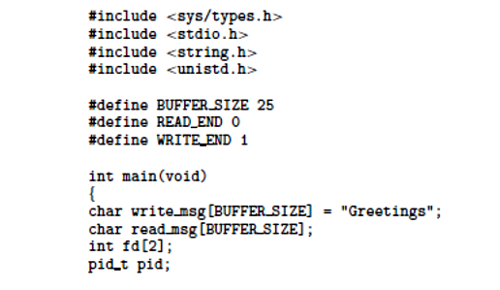
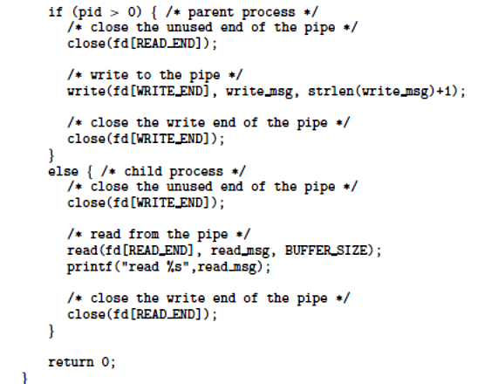
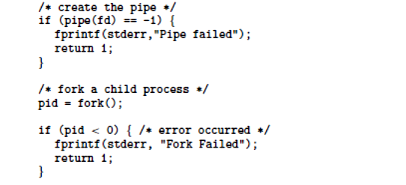
Ordinary pipe (POSIX), parent-child

Slide 10
Named pipes
Named Pipes are more powerful than ordinary pipes
Communication is bidirectional
No parent-child relationship is necessary between the communicating processes
Several processes can use the named pipe for communication
Provided on both UNIX and Windows systems
Notes:
Named Pipes are more powerful than ordinary pipes
Communication is bidirectional
No parent-child relationship is necessary between the communicating processes
Several processes can use the named pipe for communication
Provided on both UNIX and Windows systems

Slide 11
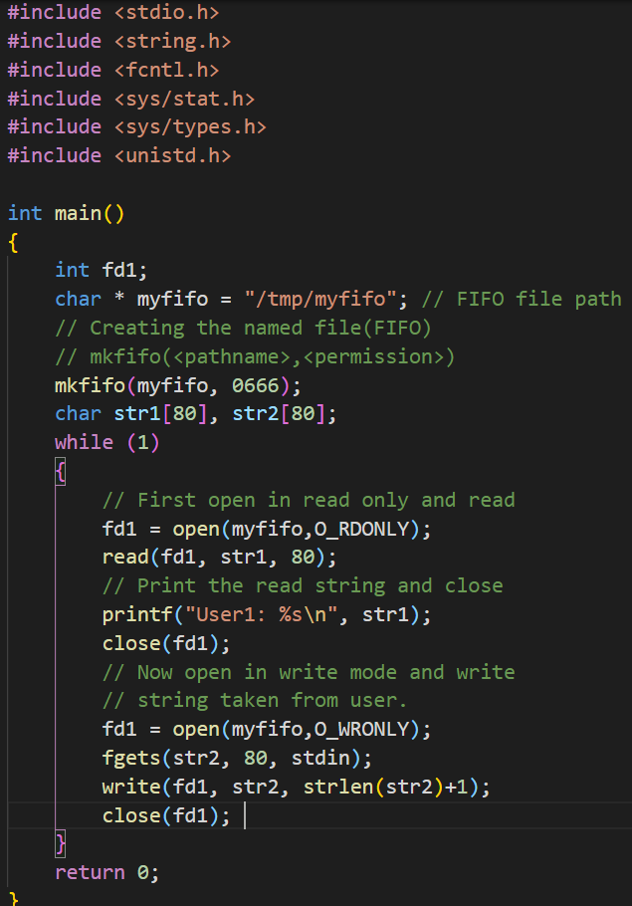
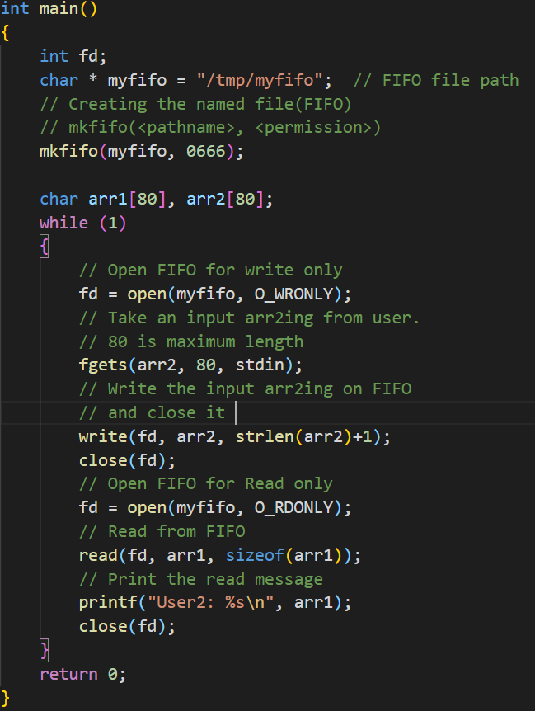
EX： Named pipe

Slide 12
Creating a FIFO file:
  In order to create a FIFO file, a function calls i.e. mkfifo is used.
int mkfifo(const char *pathname, mode_t mode);
mkfifo() makes a FIFO special file with name pathname. Here mode specifies the FIFO’s permissions.
Using FIFO: As named pipe(FIFO) is a kind of file, we can use all the system calls associated with it i.e. open, read, write, close.

Slide 13
Experiments
Experiment 1:
  shared memory communication
Experiment 2:
  ordinary pipes communication
Experiment 3:
  Named pipes communication

Slide 14


